Slide 1
LZ1 Parallel Implementation
Presenters:
Rahul Mittal
Neel Prajapati

Slide 2
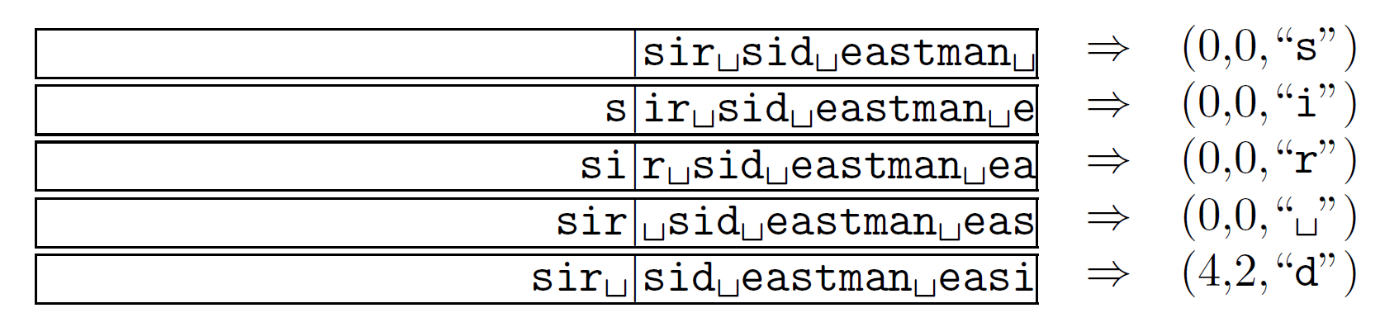
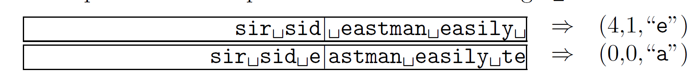
LZ1 Compression Example
Source: Data Compression-The Complete Reference

Slide 3
LZ1 Algorithm
while (input is not empty)
{
get a reference (position, length) to longest match;
if (length > 0)
{
output (position, length, next symbol);
shift the window length+1 positions along;
}else {
output (0, 0, first symbol in the lookahead buffer);
shift the window 1 character along;
}
}

Slide 4
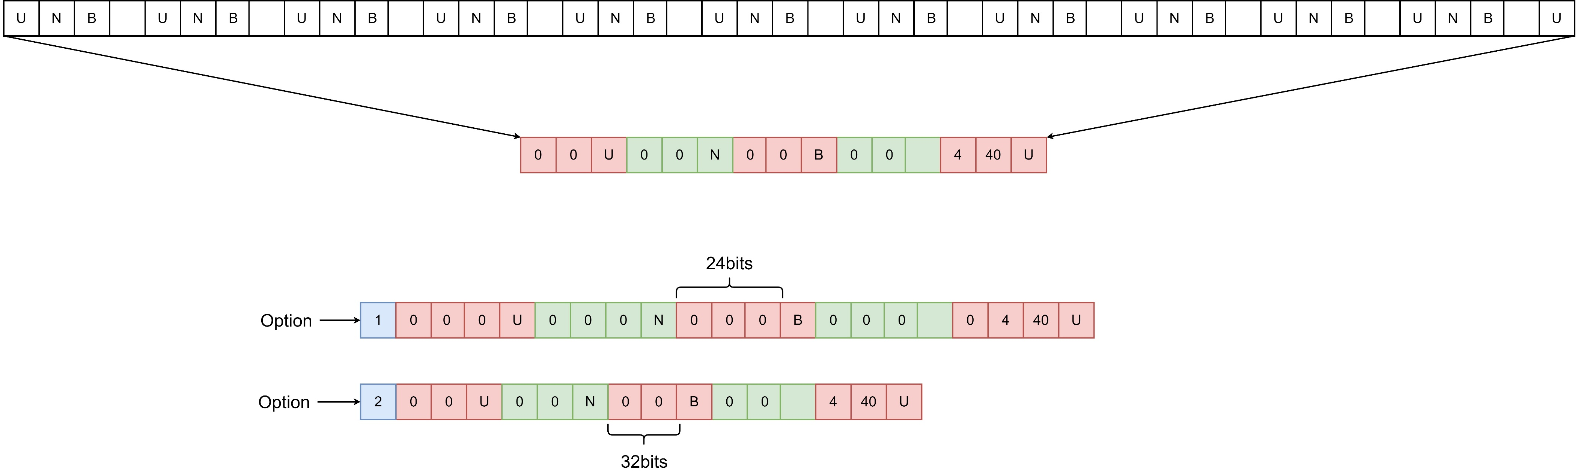
Sequential Implementation

Slide 5
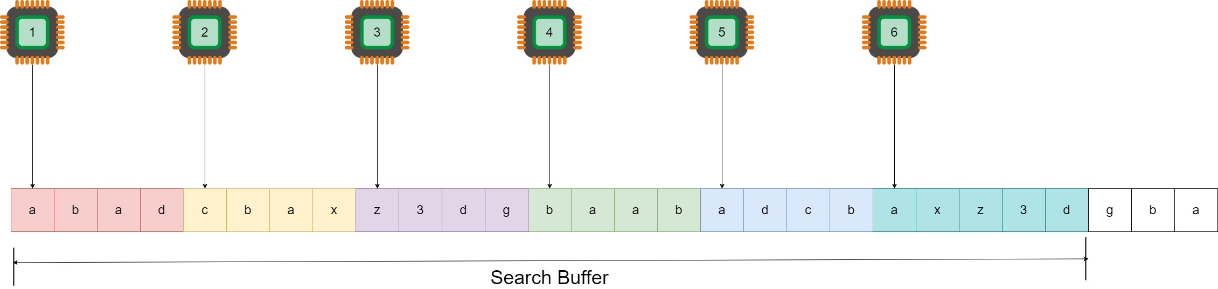
Parallel Implementations
Parallelizing the search phase on CPU:

Slide 6
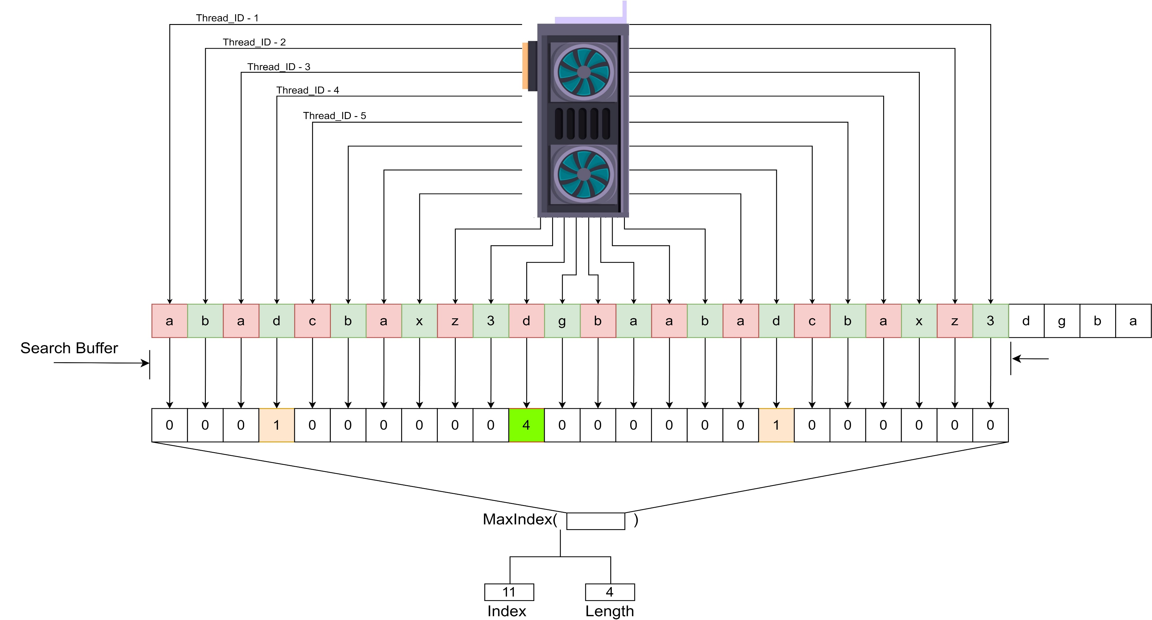
2. Parallelizing the search phase on GPU:

Slide 7
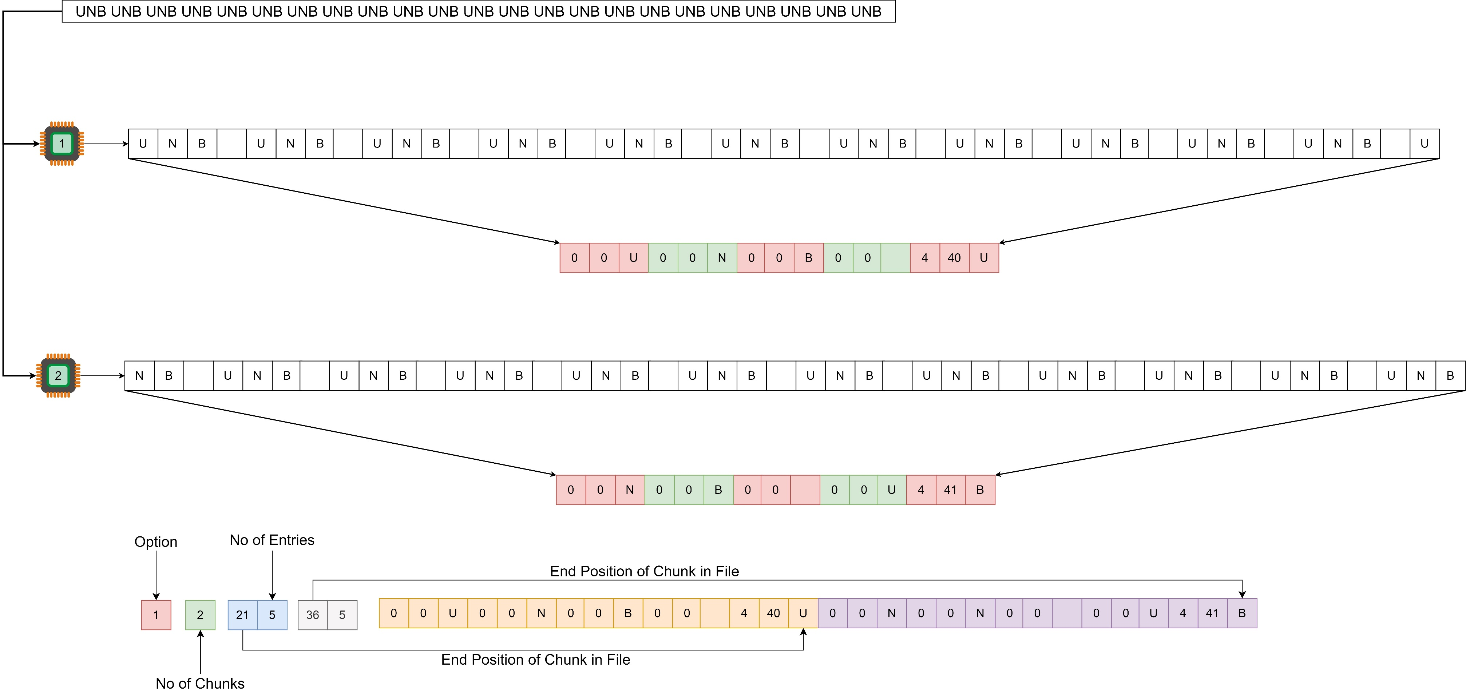
3. Dividing the Input and Compressing in Parallel

Slide 8
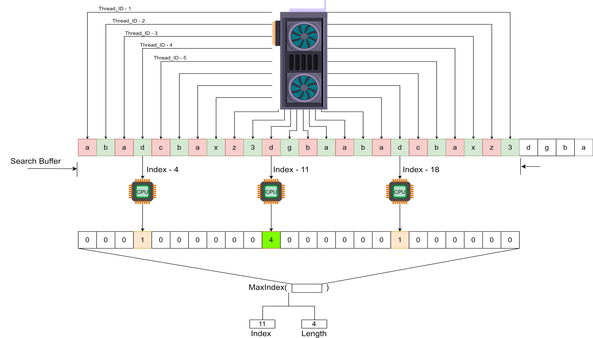
GPU + CPU Search (Stalled Efforts)

